Slide 1
Linear Regression Model of Body Dimensions
Group #7:Jiaqi Li, Yifei Deng, Sichen Feng, Changqing Su, Yanxiang Zhu

Slide 2
Group Presentation Allocation
Data Selection (Yanxiang Zhu)
Outliers (Yifei Deng)
Backward Elimination (Yifei Deng)
Collinearity (Sichen Feng)
Reduce v.s. Full (Sichen Feng)
Adjusted R-square, Mallow’s Cp, AIC, BIC (Jiaqi Li)
Conclusion & Summary (Changqing Su)

Slide 3
Introduction:
Data Information
This dataset contains 21 body dimension measurements as well as age, weight, height, and gender on 507 individuals.
The 247 men and 260 women were primarily individuals in their twenties and thirties, with a scattering of older men and women, all exercising several hours a week.

Slide 4
Introduction:
Data Information
biacromialD: biacromial diameter (cm)
biiliacD: biiliac diameter, or "pelvic breadth" (cm)
bitrochantericD: bitrochanteric diameter (cm)
chest_depth: chest depth between spine and sternum at nipple level,
mid-expiration (cm)
chestD: chest diameter at nipple level, mid-expiration (cm)
elbowD: elbow diameter, sum of two elbows (cm)
wristD: wrist diameter, sum of two wrists (cm)
kneeD: knee diameter, sum of two knees (cm)
ankleD: ankle diameter, sum of two ankles (cm)
shoulderG: shoulder girth over deltoid muscles (cm)
chestG: chest girth, nipple line in males and just above breast
tissue in females, mid-expiration (cm)
waistG: waist girth, narrowest part of torso below the rib cage,
average of contracted and relaxed position (cm)
navelG: navel (or "Abdominal") girth at umbilicus and iliac
crest, iliac crest as a landmark (cm)
hipG: hip girth at level of bitrochanteric diameter (cm)
highG: thigh girth below gluteal fold, average of right and left
girths (cm)
bicepG: bicep girth, flexed, average of right and left girths (cm)
forearmG: forearm girth, extended, palm up, average of right
and left girths (cm)
kneeG: knee girth over patella, slightly flexed position,
average of right and left girths (cm)
calfMaxG: calf maximum girth, average of right and left girths (cm)
ankleMinG: ankle minimum girth, average of right and left girths (cm)
wristMinG: wrist minimum girth, average of right and left girths (cm)
age: age (years)
height: height (cm)
gender: gender (1 - male, 0 - female)
weight: weight (kg)

Slide 5
Objective
Setting up models for how one’s weight is related to some factors of one’s body features.

Slide 6
Data Check:
Outliers
Set up the full models with all 24 predictors and with the response “weight”
Check outliers before model selection
Notes:
So, to start, we set up our full model with all 24 predictors and with the response “weight”. Then, we need to find some outliers before model selection to make sure the model will not affected by them.

Slide 7
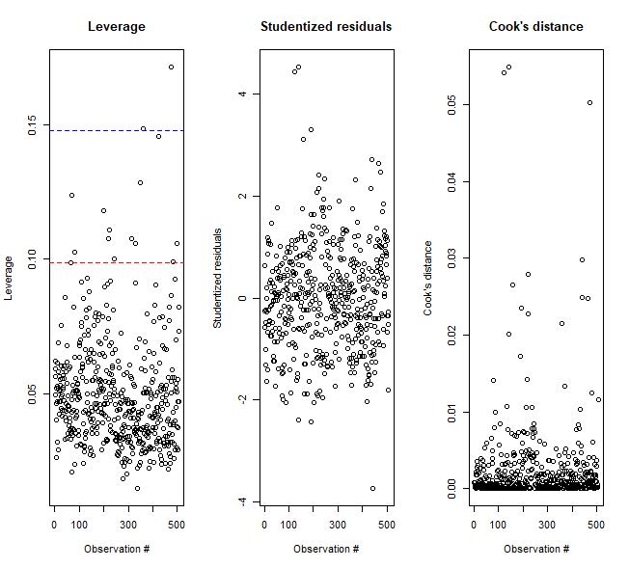
Data Check:
Outliers
Notes:
By looking at three graphs above, we could observe that we have outliers in our model. Then, to find them, we need to use “which” command to locate them.

Slide 8
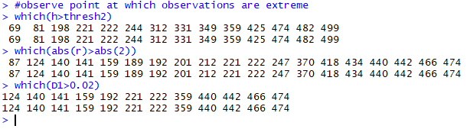
Data Check:
Outliers
3 possible outliers:
[474]
[222]
[221]
Notes:
After that, we could clearly observed that there are three outliers in x,y and cook distances as listed below, which means they will influence the model, so we decided to delete them.

Slide 9
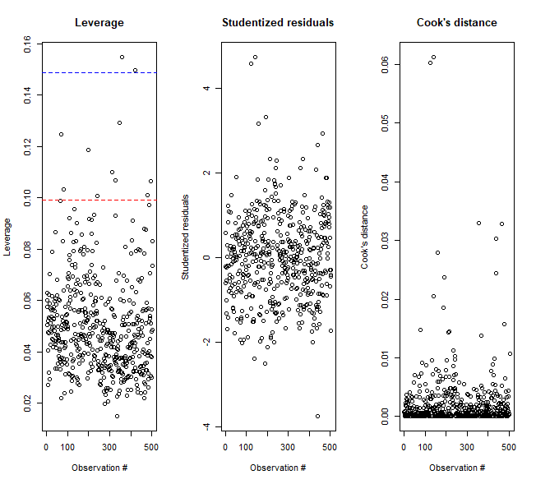
Data Check:
Outliers Remove
Notes:
After delete them, recheck those three plots, we have no outliers, so we are good to go for model selection.

Slide 10
Model Selection:
Backward Elimination
Set up Alpha-to-remove: 0.10
Remove the predictor that has the largest p-value, which also needs to be larger than 0.10 , once at a time until all predictors have p-value that is smaller than 0.10
Notes:
So our first method for model selection is backward elimination. In this case, we first set up alpha-to remove to be 0.10 and we remove the predictor with largest current p-value during each iterations and stop until we have all current p-value of the predictors that are smaller than 0.10

Slide 11
Model Selection:
Backward Elimination
Model with 15 predictors:
biiliacD, chest_depth, chestD, kneeD, shoulderG, chestG, waistG, hipG, highG, forearmG, kneeG, calfMaxG, age, height, gender
Notes:
As a result, we will have the model with 15 predictors as follow by backward elimination.

Slide 12
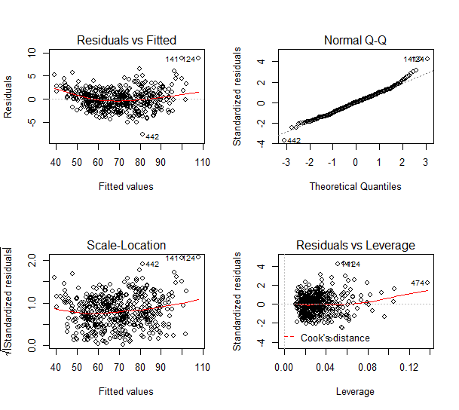
Disgnostics
Notes:
But, we will still need to check diagnostics plot to seek agreement on linearity and normality on residuals of the model. By looking at the residuals v.s. Fitted values plot, we observe an non-linear pattern, so we will need to fix it since non-linearity could cause wrong model, inaccurate prediction and possible biased explanation between variables.

Slide 13
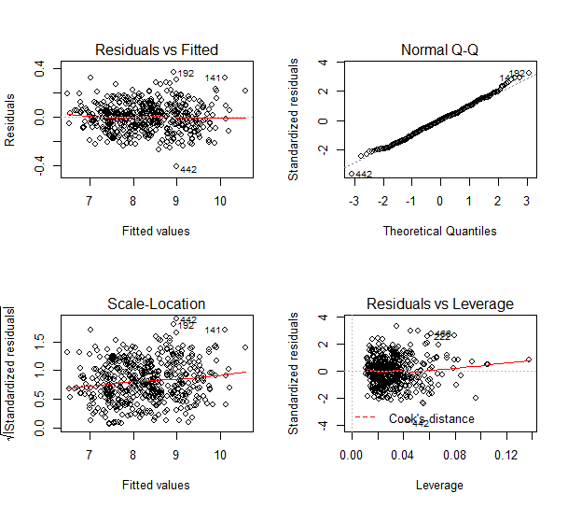
Disgnostics:
Transformation to fix linearity
Transformation of y:
y → √y
Notes:
Because the pattern is like a quadratic function, we decide to implement transformation on y from y to square root of y and by looking at the diagnostic plot, the variances are constant and we have linearity. Next, we need to check normality.

Slide 14
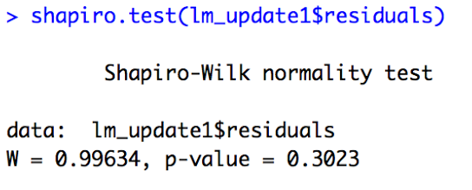
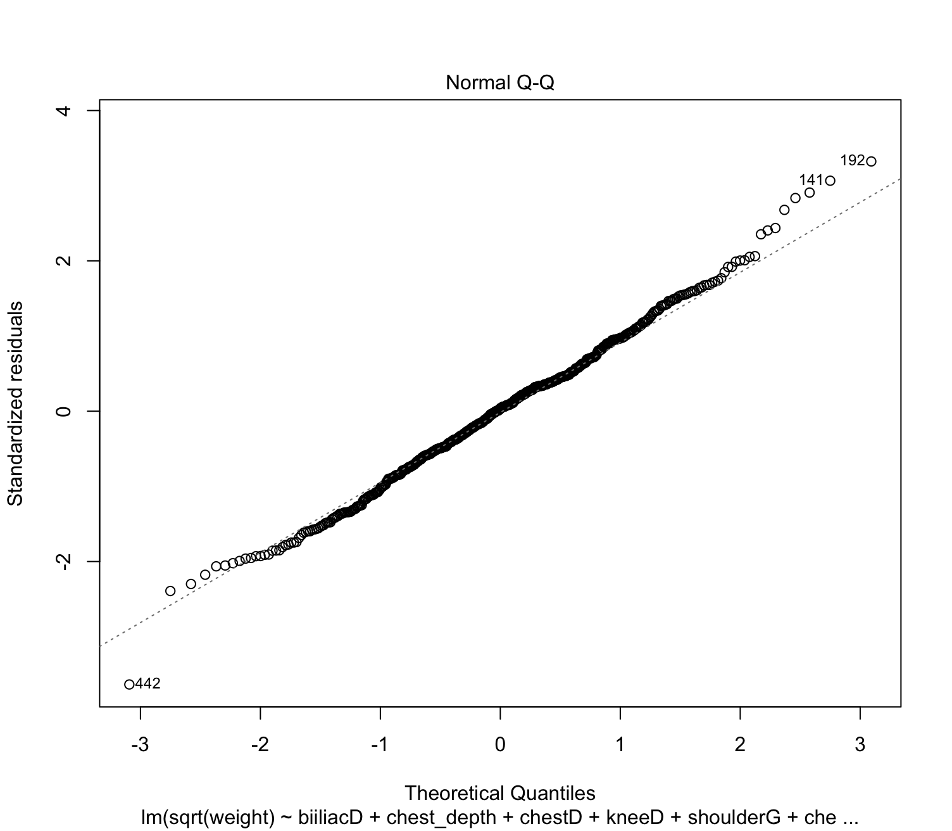
Disgnostics:
Normality check
Notes:
Then, by shapiro test, we obtain p-value > 0.05, we agree with null hypothesis that residuals are normally distributed and also could see normality from qq-plot. And next, we will need to check whether there exist correlation between each predictors.

Slide 15
Data Check:
Collinearity
Remove predictor with VIF ≧ 10
i.e. we remove “ChestG”
> vif(lm_update1)
biiliacD chest_depth chestD kneeD shoulderG
1.792888 3.487510 5.171976 3.178343 10.618901
chestG waistG hipG highG forearmG
14.285165 9.016209 7.536994 5.396063 8.569682
kneeG calfMaxG age height gender
4.239681 3.532876 1.502269 2.890987 6.864747

Slide 16
Data Check:
Remove collinearity
> vif(lm_update2)
biiliacD chest_depth chestD kneeD shoulderG
1.791362 3.184020 4.704602 3.172501 8.880029
waistG hipG highG forearmG kneeG
8.054950 7.536255 5.381420 7.527554 4.196666
calfMaxG age height gender
3.466797 1.502139 2.889287 6.811377

Slide 17
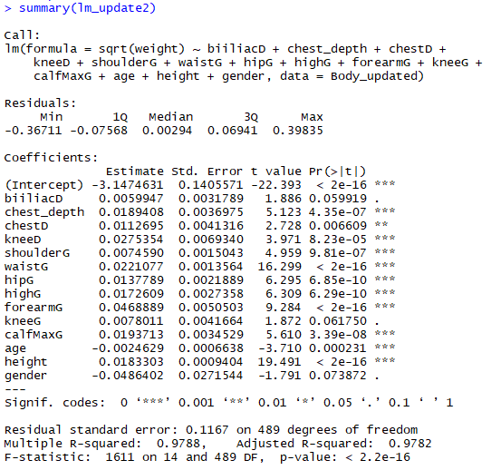
Comparison:
Reduced vs Full
Predictors with p-value > 0.05:
gender kneeG biiliacD

Slide 18
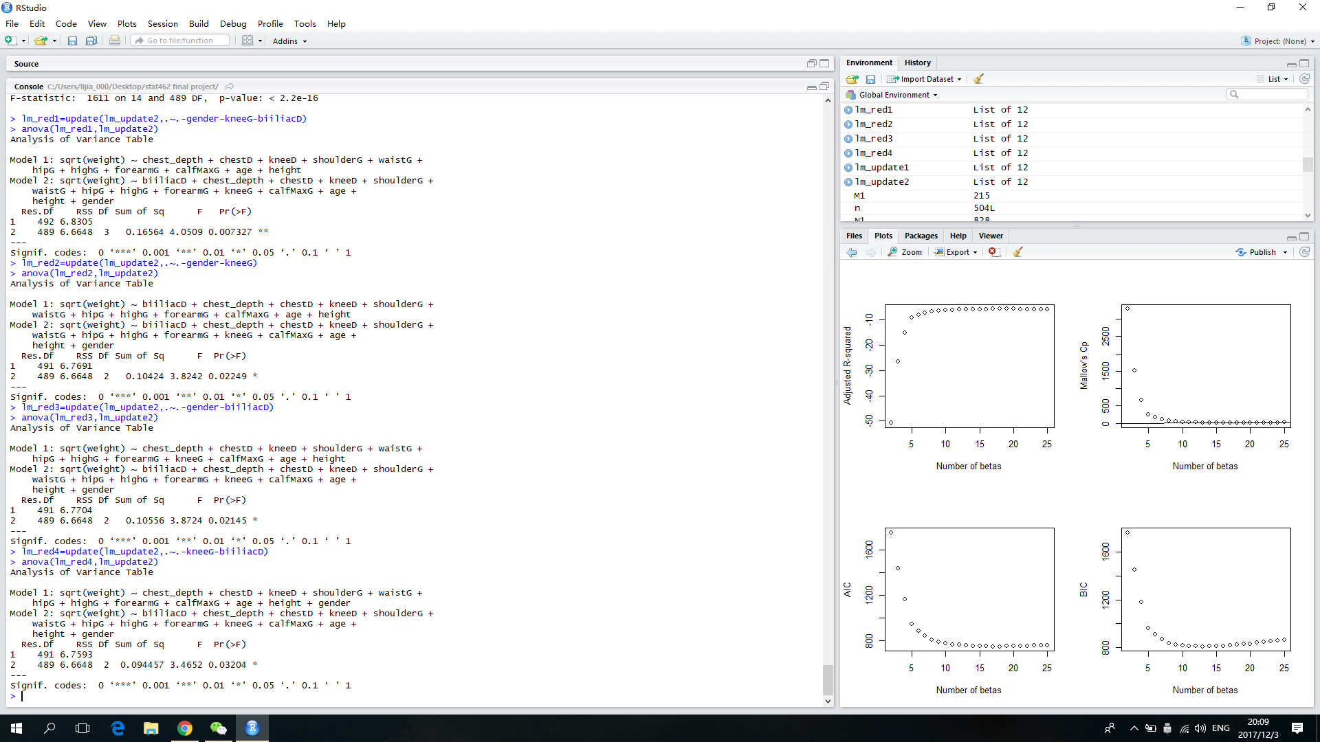
Comparison:
Reduced vs Full

Slide 19
Comparison:
Reduced vs Full
Conclusion:
So, we keep gender, kneeG, biiliacD in the model

Slide 20
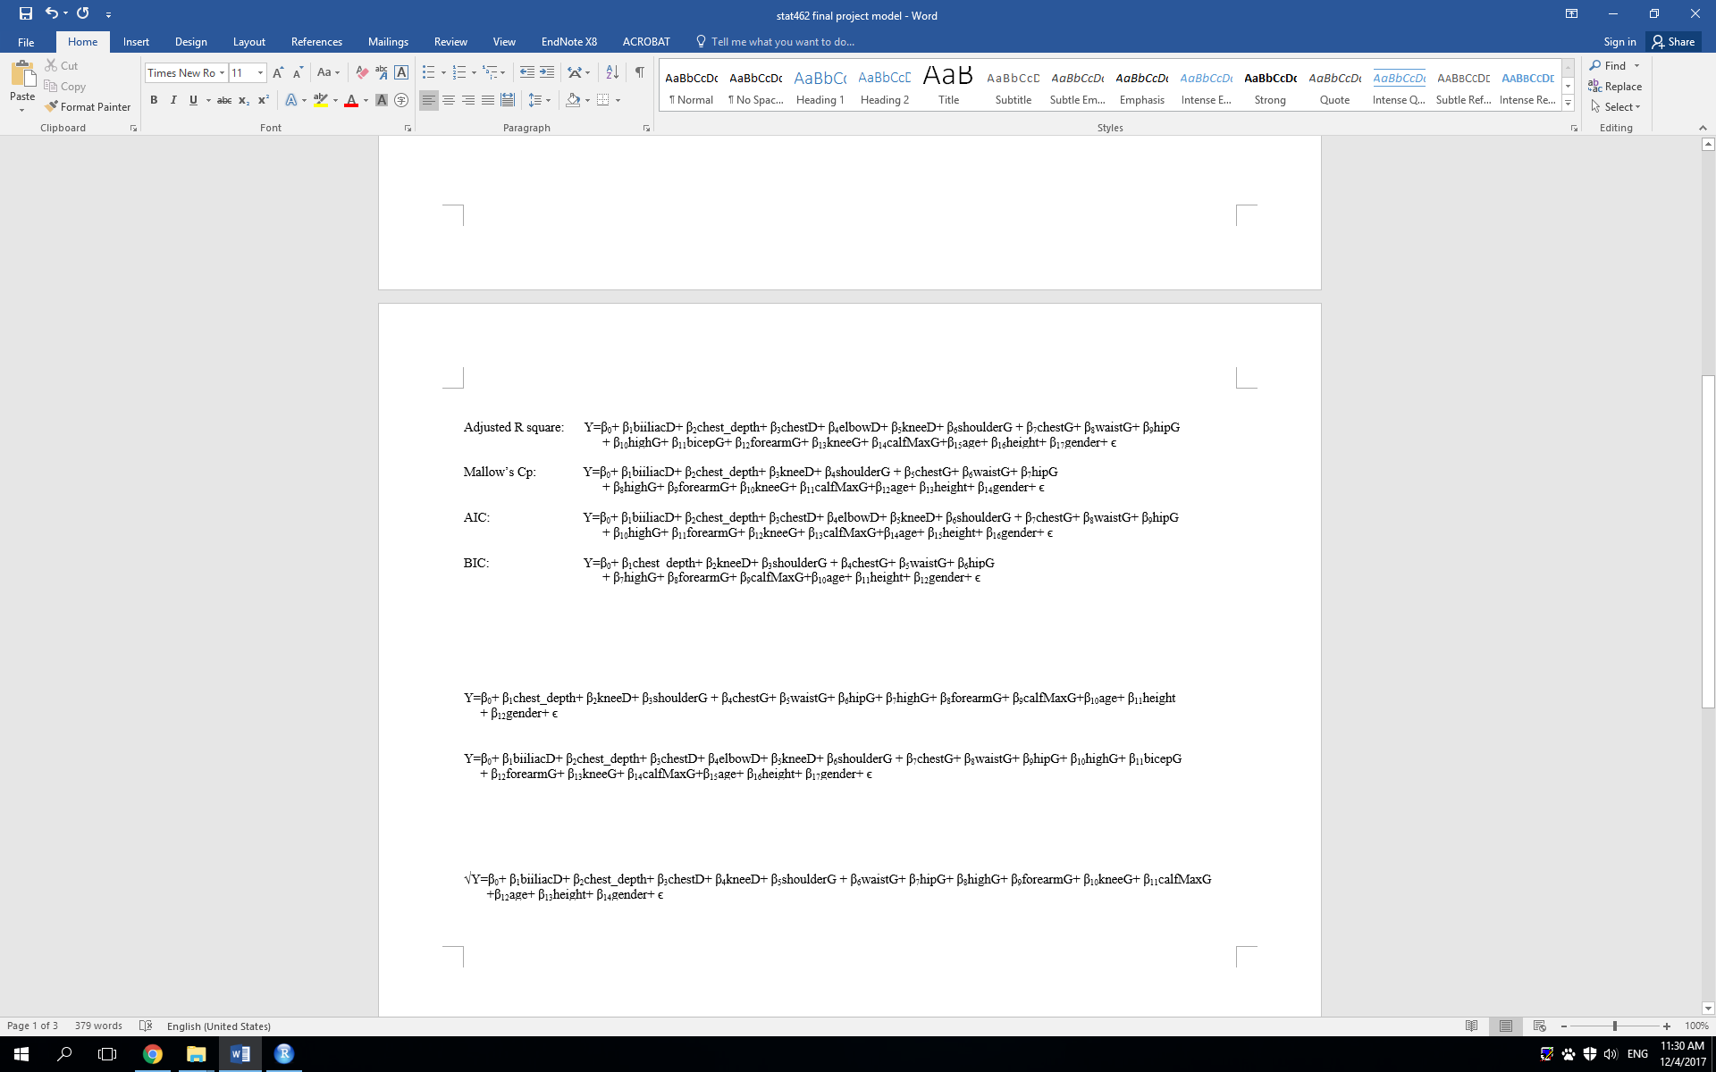
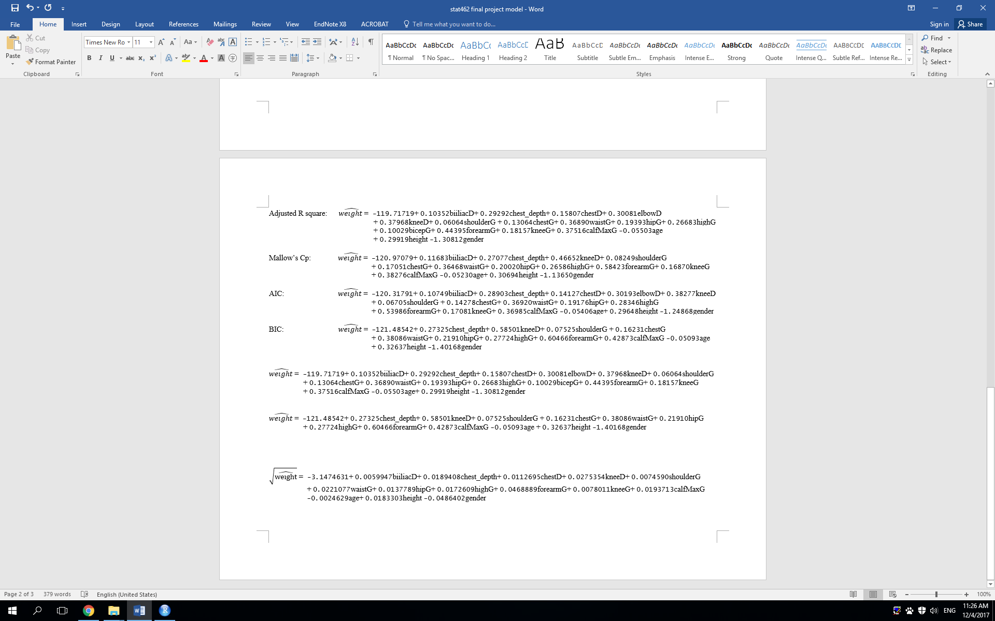
Model Selection:
Backward Elimination
This model has 14 predictors and 15 betas:
The estimated regression model:

Slide 21
Model Selection:
Adjusted R square
Mallow’s Cp
AIC
BIC
We want to try more methods in model selections to see if there exist some other models

Slide 22
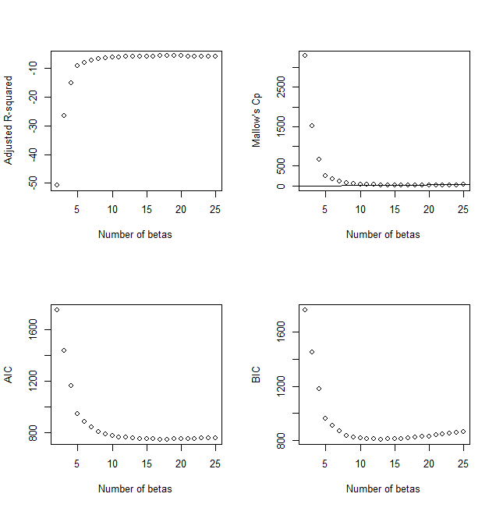
Model Selection:
Adjusted R square
Mallow’s Cp
AIC
BIC

Slide 23
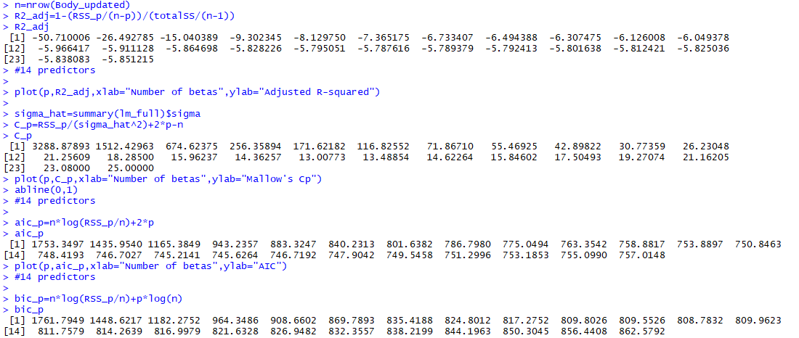
Model Selection:
Details
Remark:
For Mallow’s Cp, since we want a model with small p and with Cp close to p, then we choose p = 15. (i.e. 14 predictors)

Slide 24
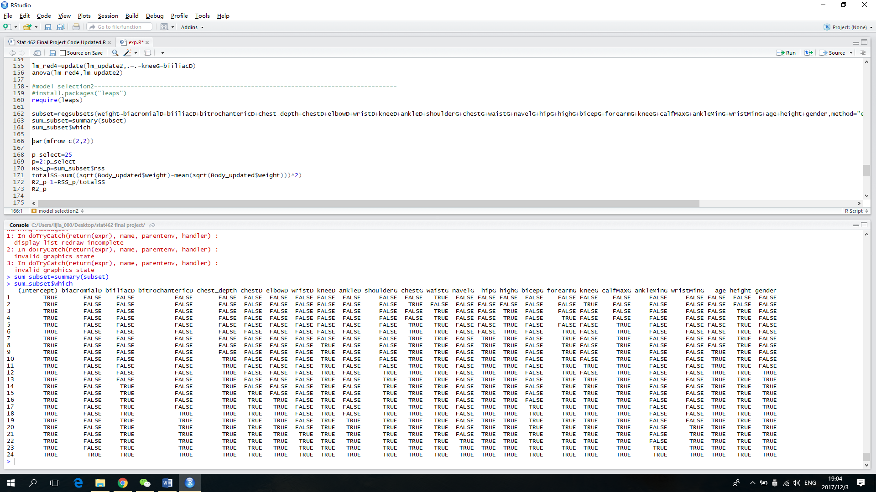
Model Selection:
Adjusted R square: 17 predictors
Mallow’s Cp: 14 predictors
AIC: 16 predictors
BIC: 12 predictors

Slide 25
Model Selection:

Slide 26

Model Selection:

Slide 27
Summary
According the analysis report, we experienced many questions about how to make our models better.

Slide 28
Questions & Answers
Do there exist any unusual data (outliers)?
Yes. We found 3 outliers and removed them from the data set by using leverage plot, studentized residual plot, and cook’s distance plot.
2. How to we choose predictors?
Firstly, we used backward elimination to obtain an acceptable model with 15 predictors. We also used square root transformation to make the model more reliable.
3. Does there exist collinearity that has large influence?
Yes. One predictor (ChestG) has large variance inflation factor (VIF). That means chest girth has variance that is heavily affected by the collinearity.
4. Do there exist any other models which is good?
Yes. We tried adjust adjusted R-square, Mallow’s Cp, AIC, BIC. We found 4 different models that each has 17, 14, 16, 12 predictors.

Slide 29

Conclusion:
Adjusted R-square, Mallow’s Cp, AIC, BIC:
If we want to get a simpler model, we want to choose model selected by BIC, which has 12 predictors and 13 betas:
If we want to get a more useful model, we want to choose model selected by Adjusted R-square, which has 17 predictors and 18 betas:
Backward Selection:
This model has 14 predictors and 15 betas:

Slide 30
Conclusion:
After all of the analysis process, we found two effective models that could estimate how people’s weight is related to other body features.
For the sake of simpleness, we can use the model that contains 12 predictors with weight as a response.
According to the predicted equation, the forearm girth has the strongest linear relationship with weight. The increase of 1 cm of forearm girth will cause 0.44395 kg increase in weight.
For the sake of completeness and usefulness, we can use the model that contains 17 predictors with weight as a response.
According to the predicted equation, the forearm girth has the strongest linear relationship with weight. The increase of 1 cm of forearm girth will cause 0.60466 kg increase in weight.

Slide 31
Reference
Journal of Statistics Education - Data Archive. Accessed October 26, 2017. http://ww2.amstat.org/publications/jse/jse_data_archive.htm.

Slide 32
Thank You
Group #7:Jiaqi Li, Yifei Deng, Sichen Feng, Changqing Su, Yanxiang Zhu

